Slide 1

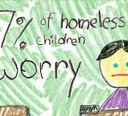
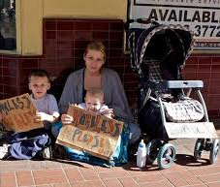


Homeless Population in 2016
Edwin Brown UMBC Data 690 Science Capstone
HUD, FRED, and Kaggle Data Set

Slide 2
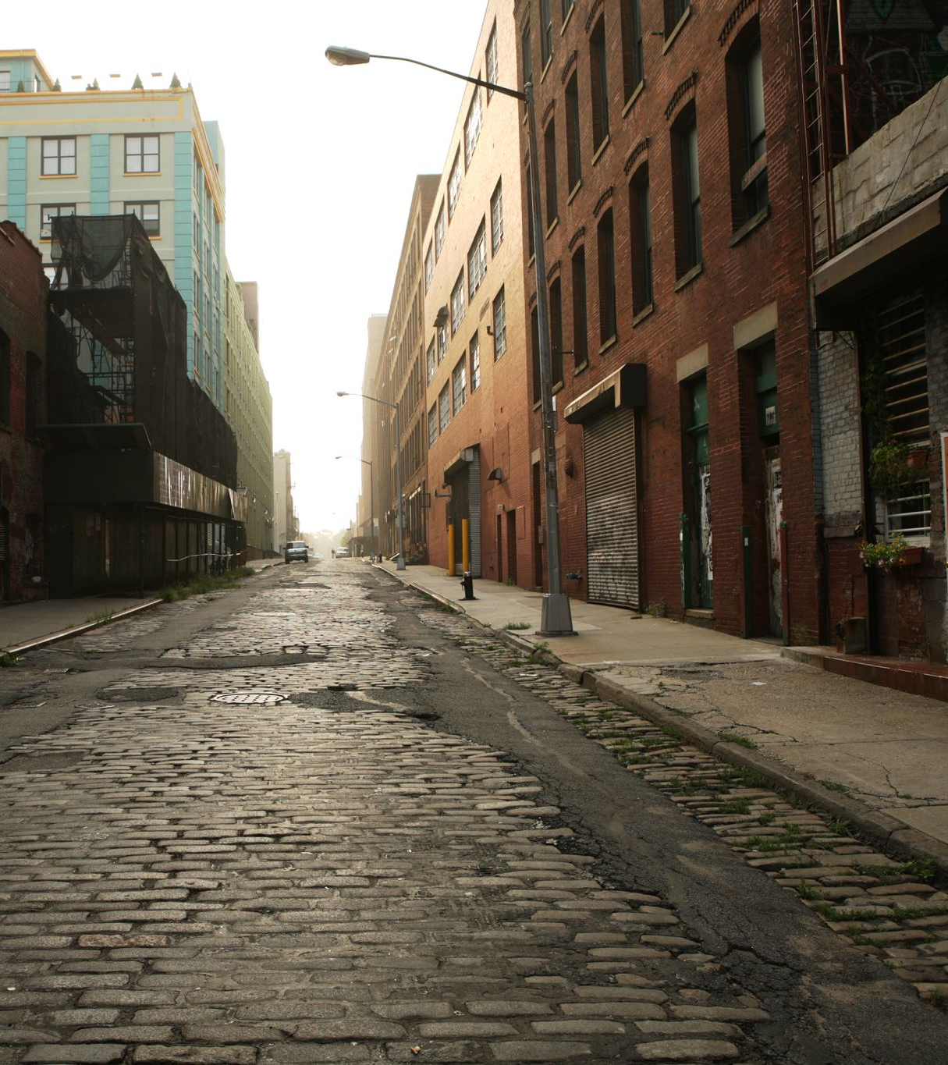
Features
An unsheltered homeless person resides in: In a place not meant for human habitation, such as cars, parks, sidewalks, abandoned buildings (on the street).
A sheltered homeless person resides in: In an emergency shelter.
19 Features
5 independent Features
1 dependent Feature

Slide 3
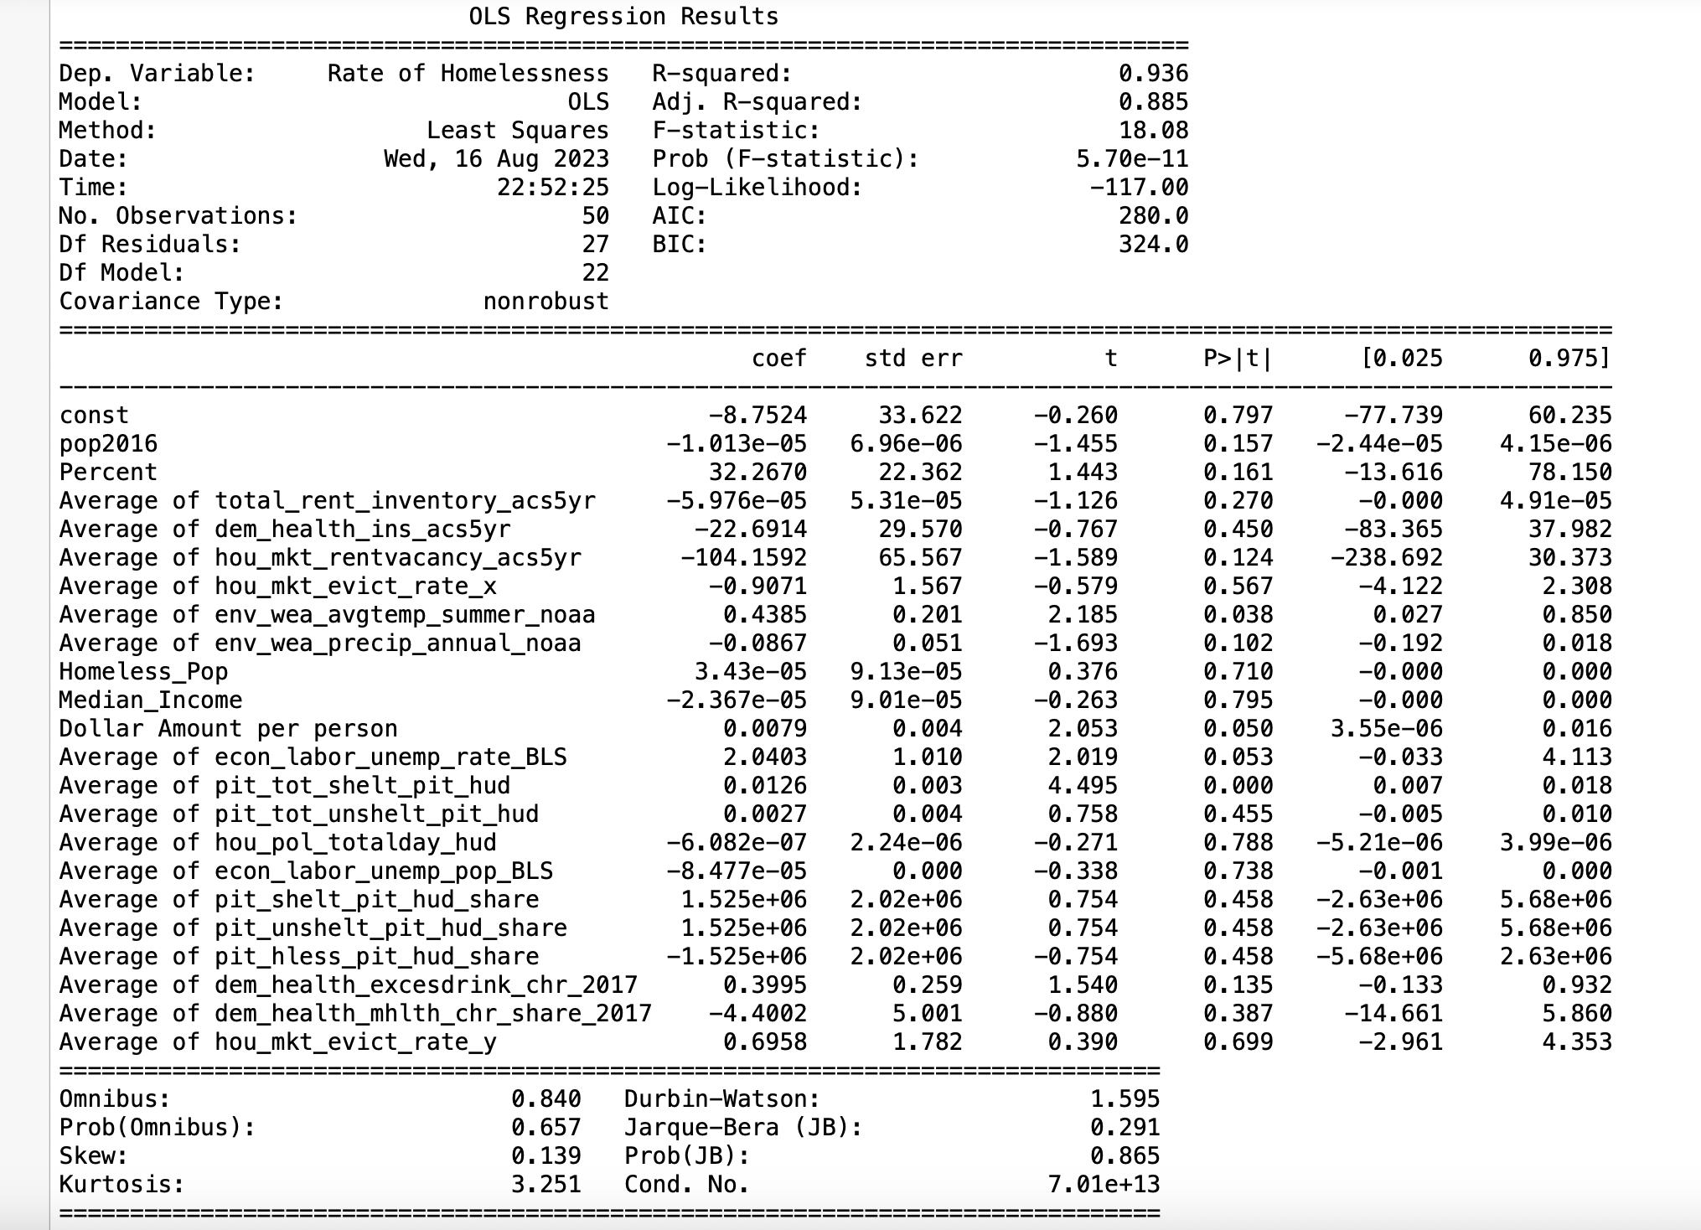







Features Gathered From Data

Slide 4
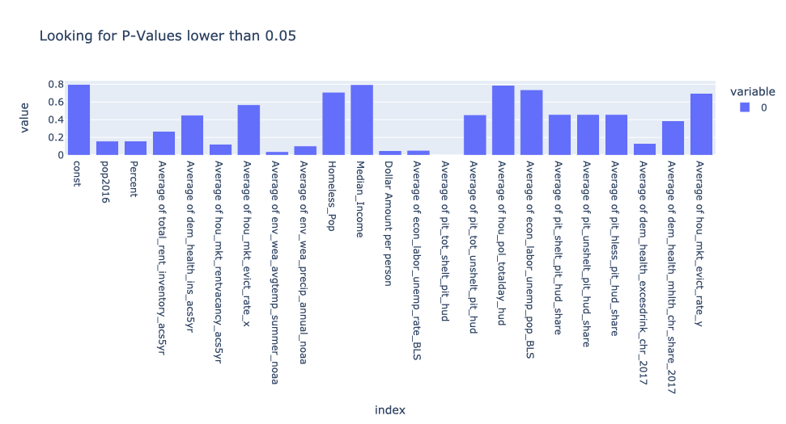
Features with less than P-Value of 0.05 were selected

Slide 5
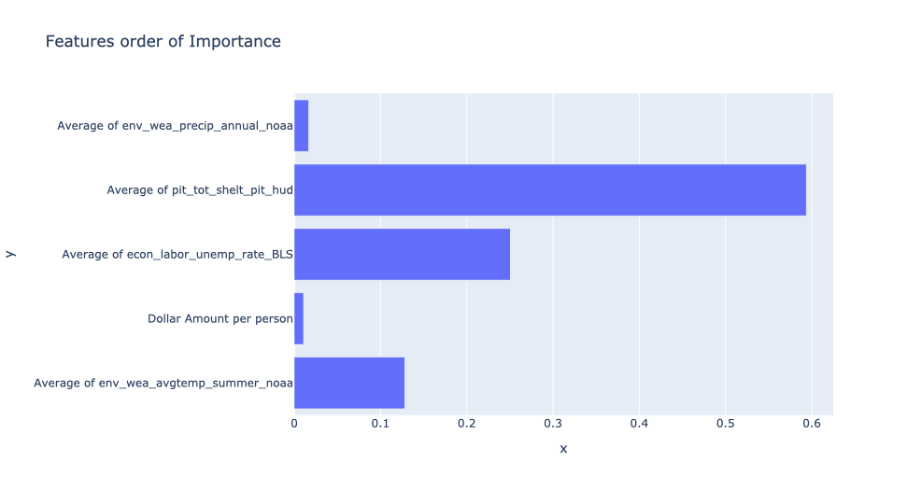
Order of importance The higher the score the more significant

Slide 6
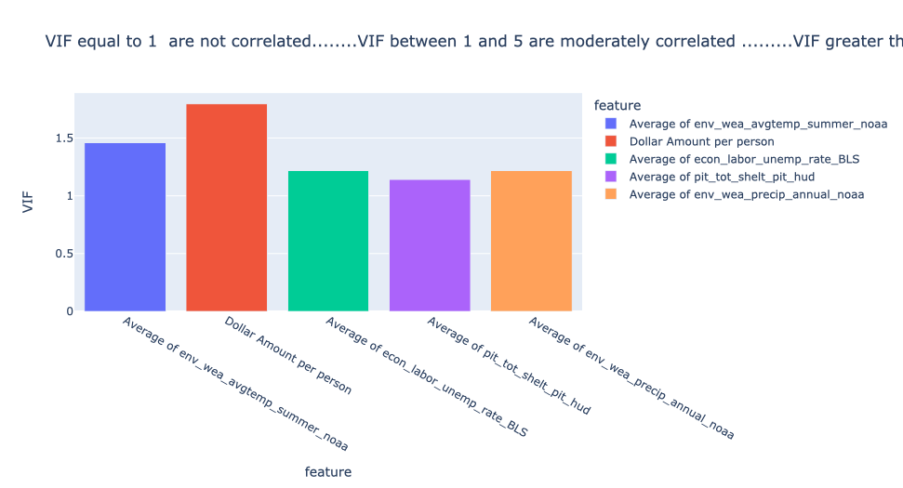
Vif = 1 not correlated Vif 1 < 5 moderately correlated Vif 5 > correlated

Slide 7
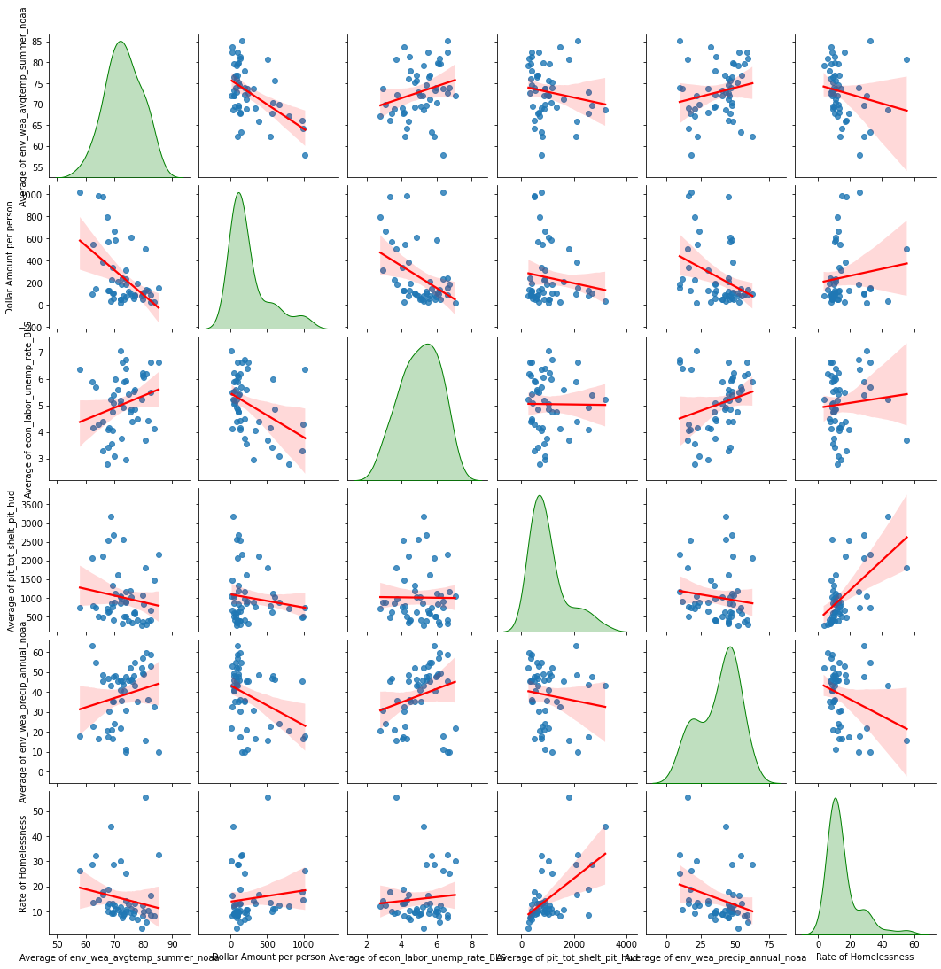
Positive: Dollar Amount, Unemployment, Sheltered Negative: Weather, Precipitation

Slide 8
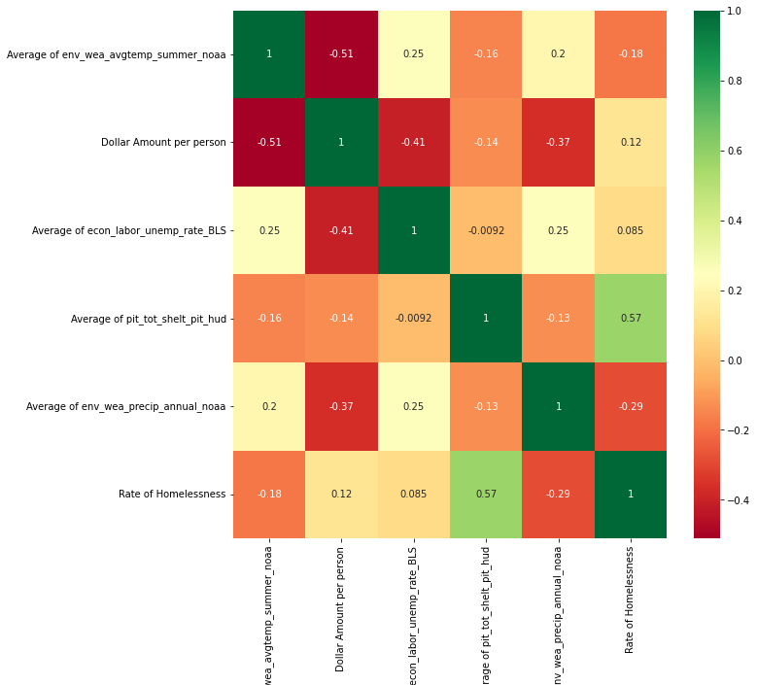
Numeric Correlation
Weather
Accessibility
Economic

Slide 9
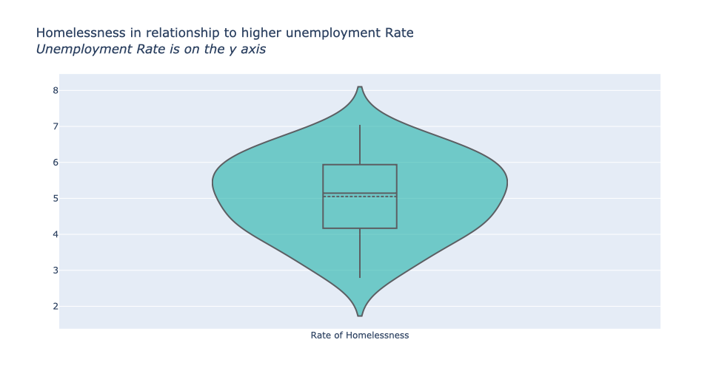
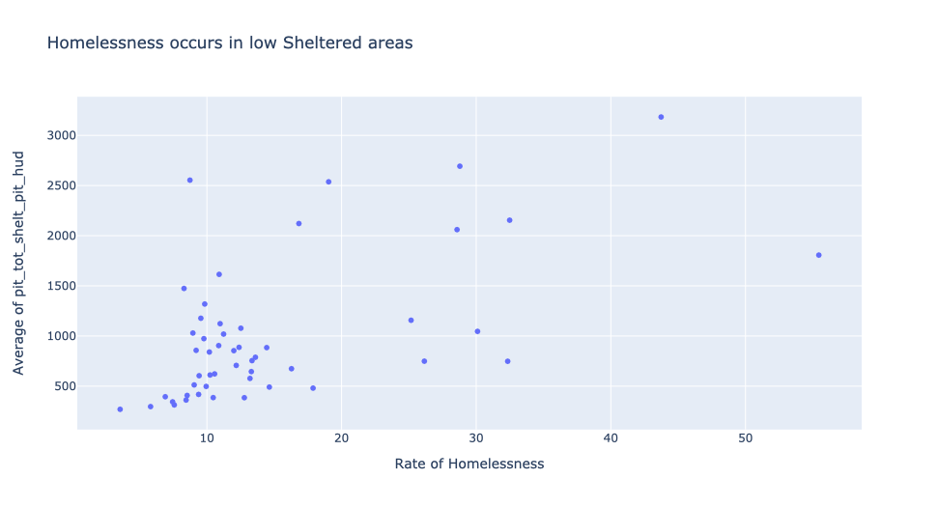
Not enough Shelters & High unemployment has impact on Higher Homelessness

Slide 10
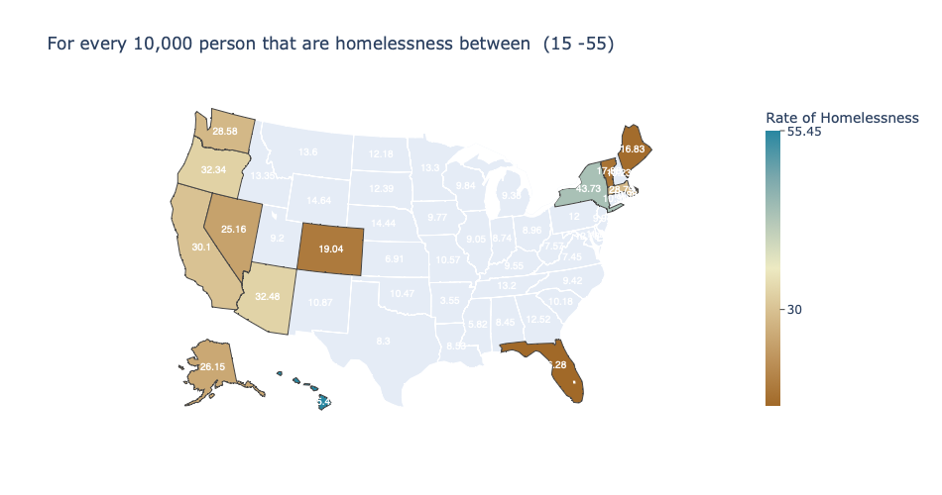
Top States with Highest rate of homelessness
For Hawaii there are 55.45 person homeless for a population of 10,000 people | State
55.45 | Hawaii
43.73 | New York
32.48 | Arizona
32.34 | Oregon
30.10 | California
28.79 | Massachusetts
28.58 | Washington

Slide 11
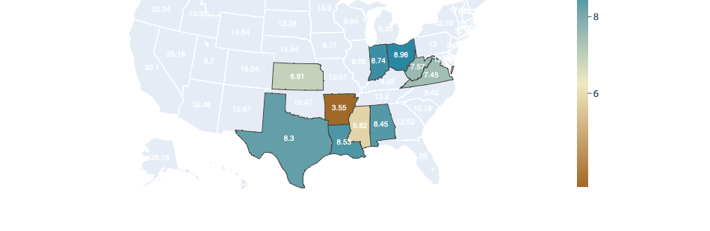
Top States with Lowest rate of homelessness
For Arkansas there are 3.35 person homeless for a population of 10,000 people | State
3.35 | Arkansas
5.82 | Mississippi
6.91 | Kansas
7.45 | Virgina
8.38 | West Virgina
8.45 | Texas

Slide 12
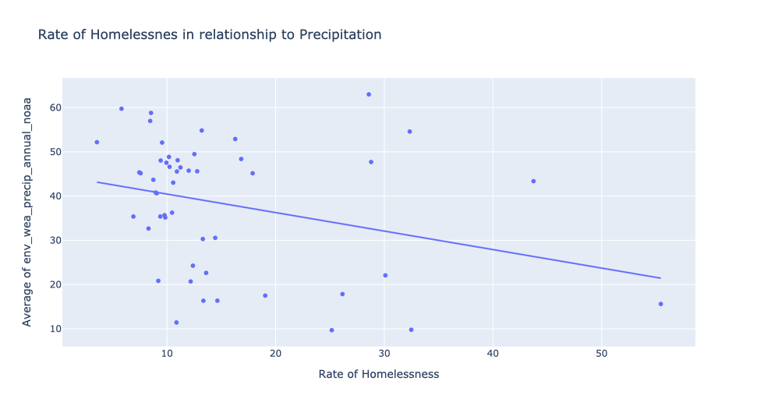
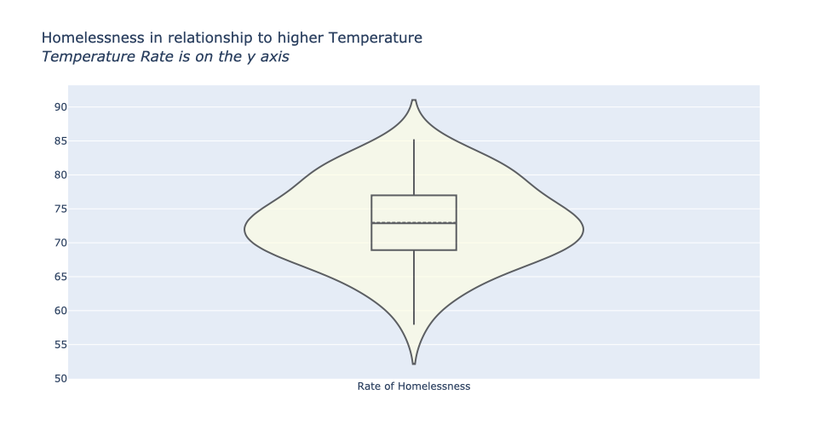
Climate Change Impact on Homelessness – Less precipitation and higher temperature

Slide 13
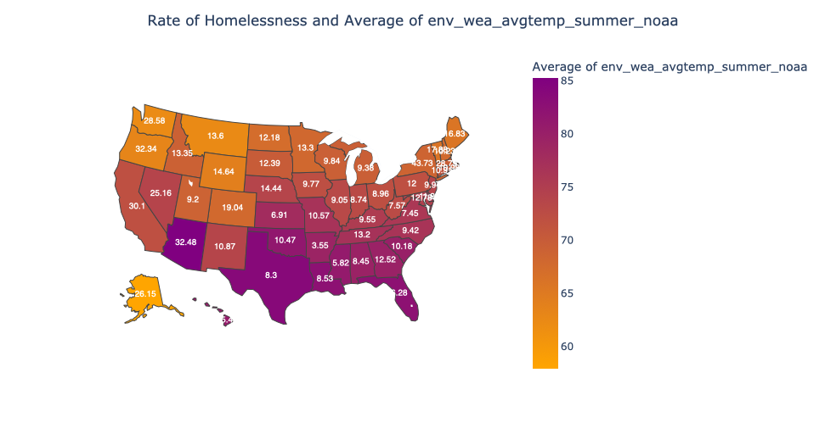
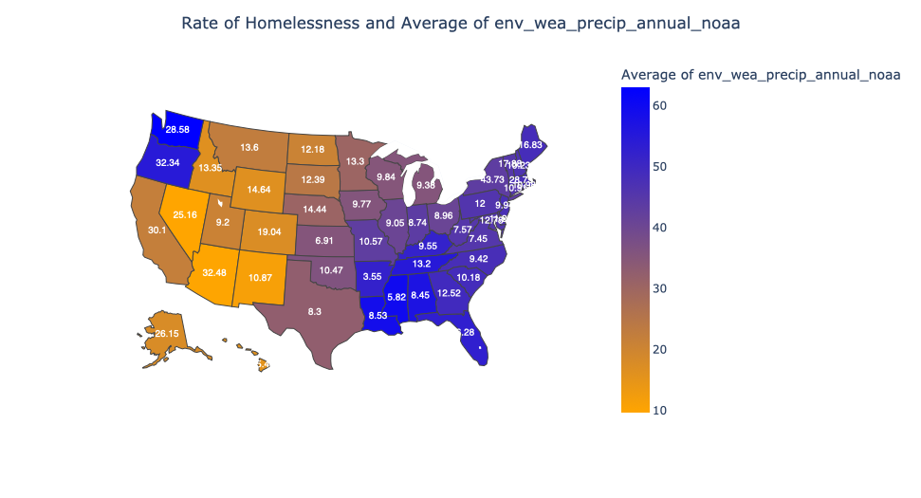
Climate Impact

Slide 14
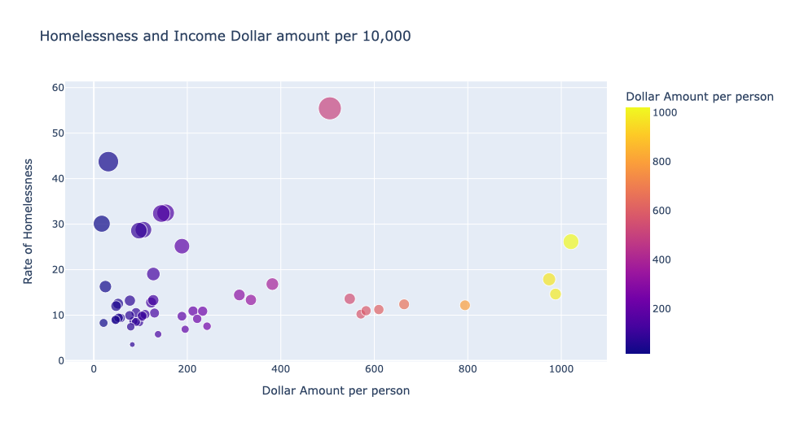
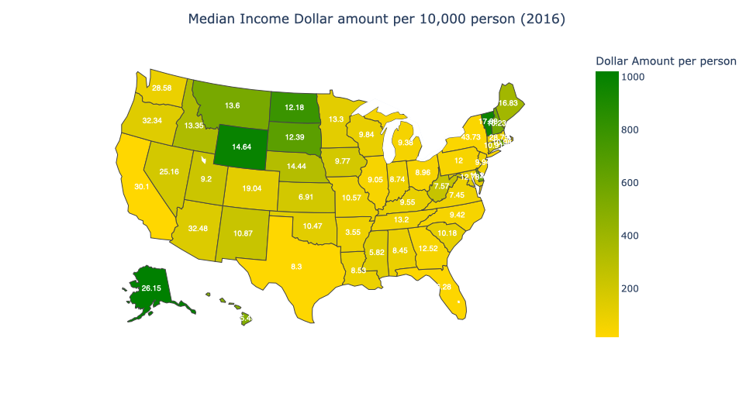
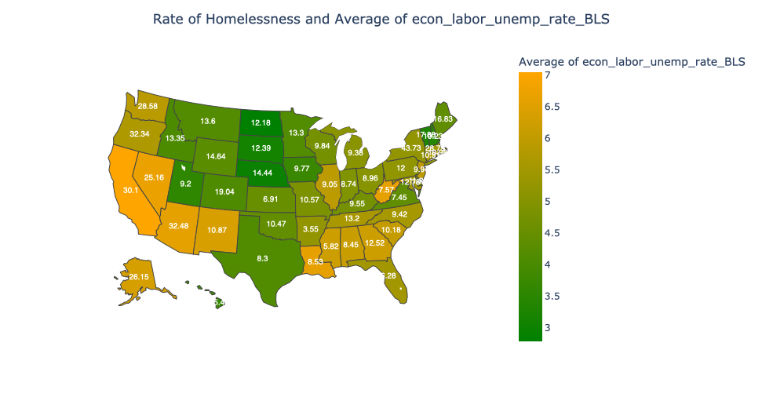
Economic Impact Low median Income Dollar, high unemployment rate

Slide 15
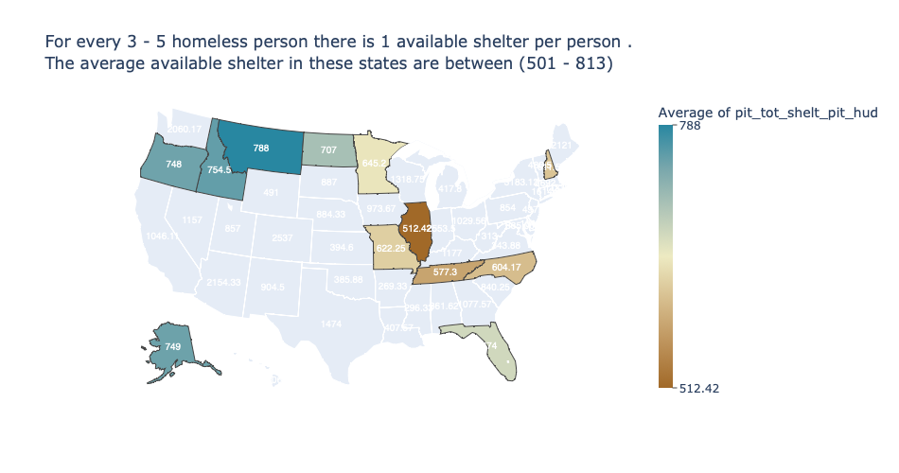
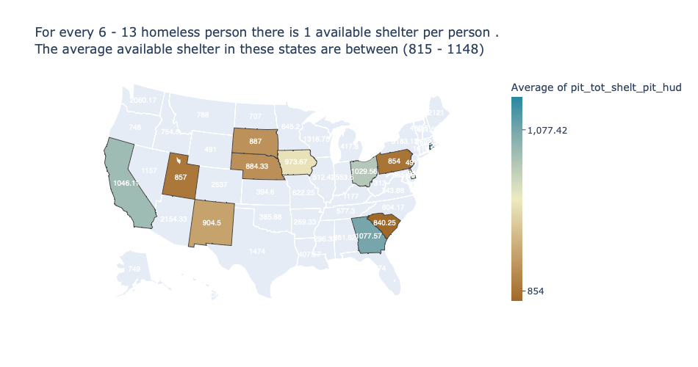
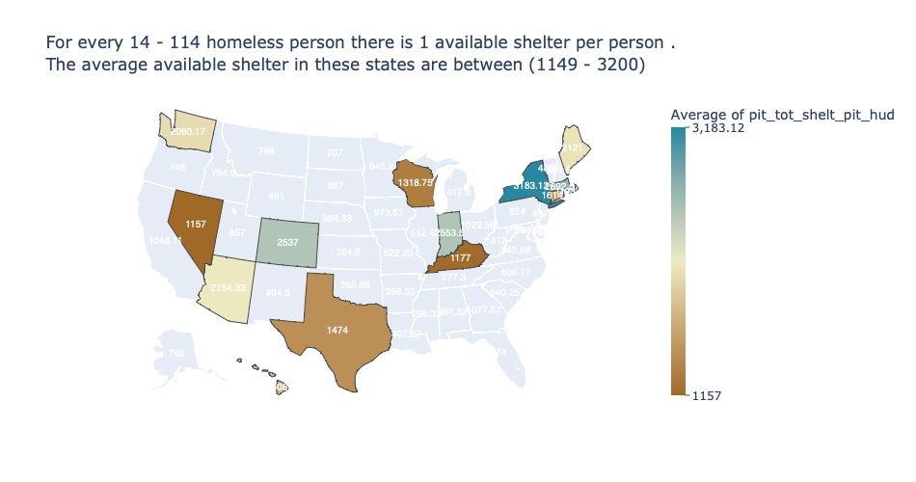
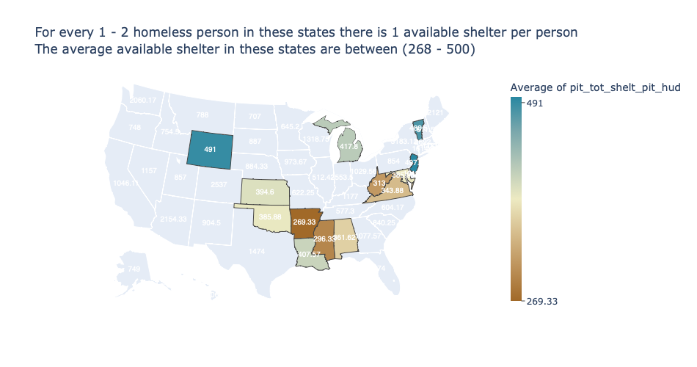
Access to Shelter per Homeless person
For a range of 3 – 5 homeless person in states like Alaska and Oregon there is 1 shelter available. Most states do not have adequate access to shelters

Slide 16
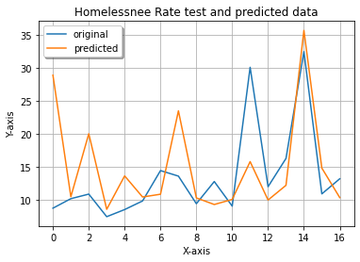
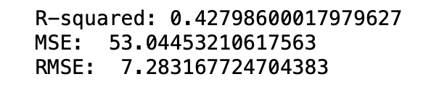
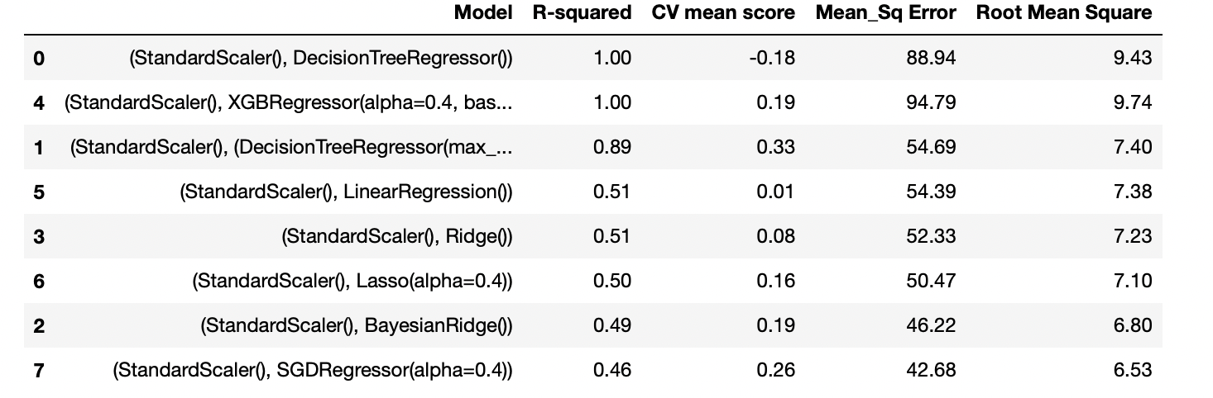
Best Model SGDRegressor ,
Lasso,
SGDRegressor ,
LinearRegression,
Ridge,
BayesianRidge
XGBRegressor
DecisionTreeRegressor
RandomForestRegressor

Slide 17


Insights and Factors
Some of highest rate of Homelessness occurs in tourist states
Hawaii
New York
Arizona
Oregon
California
Some of lowest rate of Homelessness per state(high precipitation, Mild Temp.)
Arkansas
Mississippi
Kansas
Virginia
West Virginia
The less precipitation (snow, rain, etc) and more temperature raise
High unemployment
Median Low income
Low Access to Shelters

Slide 18
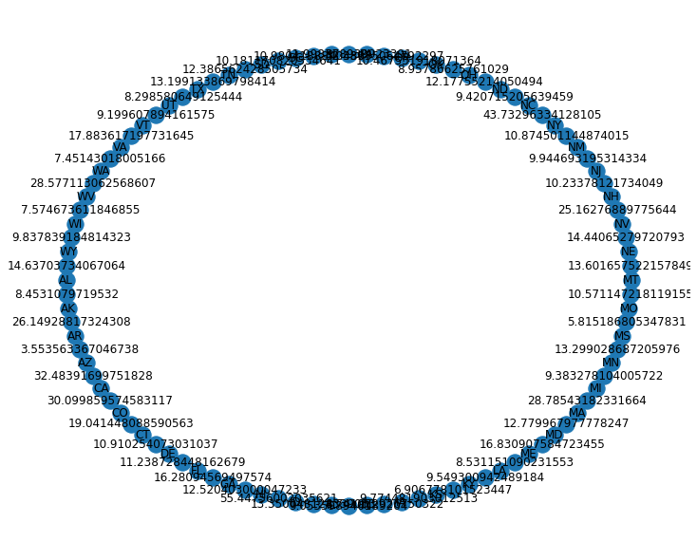
What is next? Graph Analysis Revise based on comments Test other features to see if there is an impact homelessness such as drinking water, access to health and crime levels

Slide 19

Question and Comments

